Slide 1

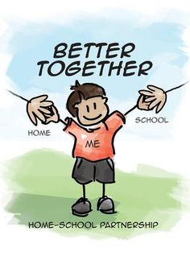
Welcome to a new school year
Working in Partnership
Uniform
Communication

Slide 2
Apollo Base
Apollo is a small Social Communication base. We follow the EYFS Reception curriculum but also take part in Forest School and cookery sessions. We have a speech and Language therapist that works with our class once a week and delivers bespoke interventions to individuals.

Slide 3
Apollo Timetable
8:45 - 9 | Welcome, coat off, funky finger activities.
9 – 9:10 | Morning meeting
9:10 -10:10 | Phonics and maths activities
10:10 – 10:30 | Toilet time, wash hands and snack
10:30 – 10:45 | Read through stories and number rhymes and songs
10:45 – 11:30 | Garden Time
11:30 – 11:45 | Tidy and Wash Hands
11:45 – 1pm | Lunch, songs, garden time
1 – 1:20 | Bucket time, dough disco and movement songs
1:20 -2pm | Focused Daily activity and free choice
2pm | Toilet and Wash Hands
2:10 -2:20 | Snack time
2:20 -2:40 | Garden time
2:40 – 2:50 | Story
2:50 – 3pm | Get ready for home.

Slide 4
Key Messages
Please ensure all items of uniform are clearly labelled.
No items from home to be brought into school such as toys.
Please use Dojo or request a phone call if you need to speak to Apollo Staff.

