Slide 1

Welcome
Eastway Primary School
The purpose of this meeting is to:
Hear about our whole school expectations and working with our families.
Meet your child’s class teacher.
Find out more information about what is taught and when.
Know what the class routines are and things specifically important to our year group.
Understand the Standards expected at the end of the year for Maths and English.
Look at ways we can all work together.
It is not an opportunity to discuss your child’s progress or individual needs. If you do need to speak to your child’s class teacher- please make a separate appointment.

Slide 2

Headteacher Message
Welcome to a new school year
Working in Partnership
Uniform
Home Learning
Attendance
Communication

Slide 3
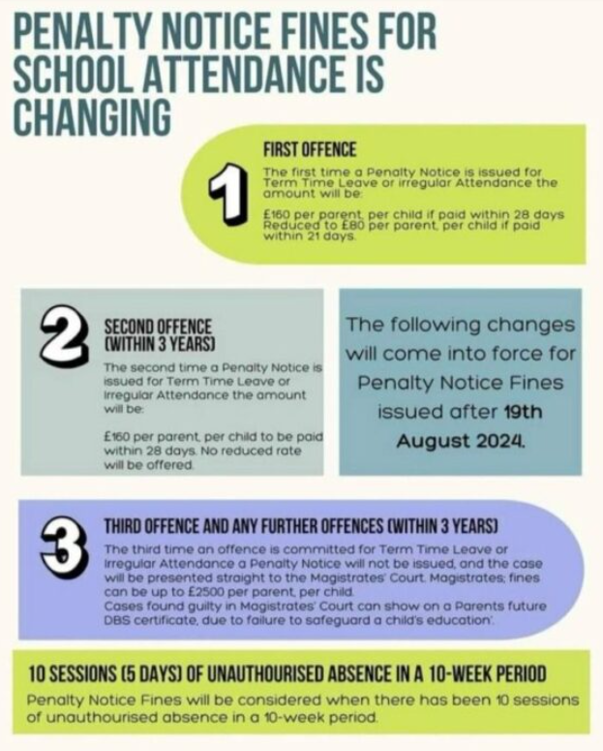
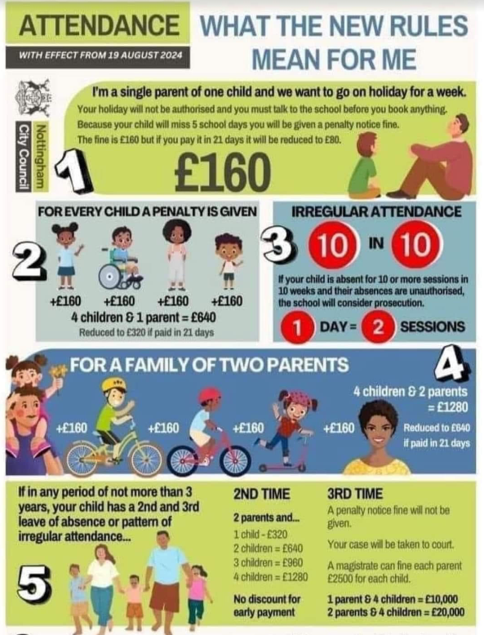
Attendance Update

Slide 4
Meet the Teacher
Welcome to Year 5
Teacher: Mr Saunderson
Learning Support: Miss Forsey, Mr Hancox, Miss Cox

Slide 5
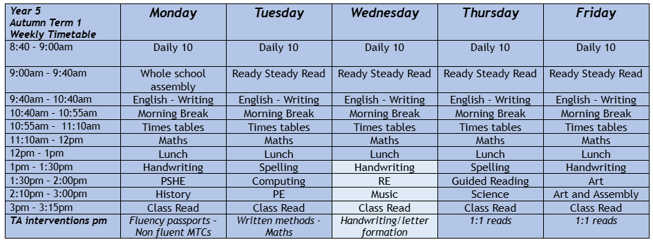
Year 5 Timetable

Slide 6
Key Messages
Independence- uniform, labelling, PE kit, letters
Multiplication Check (May)
Items from home
Home Learning
Spelling
Reading Books
Curriculum
Class Reps- how we can work with parents

Slide 7
What to bring to school?
Book bag
Home school reading book (levelled)
Class library book (to share at home)
Reading record book
Daily Books should be brought to school EVERYDAY
Notes:
Now I’m going onto what your child will be bringing home.
Last week your child was sent with their blue book bag/ reading folder (show) containing:
An Oxford Reading Tree book
A Reading Record
A Library book
And their word wallets
They will be sent home each evening and should be returned to school every morning. The books will be changed weekly depending on the day the child reads at school.

Slide 8
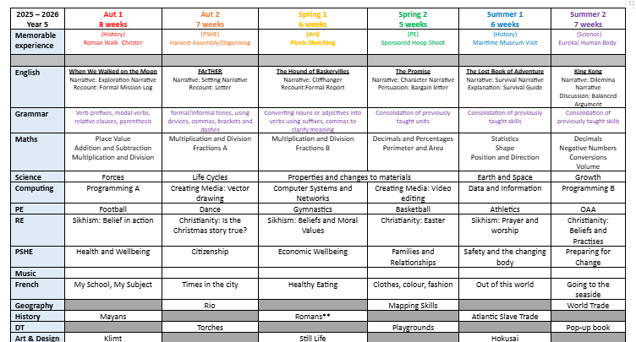
Year 5 Curriculum

Slide 9
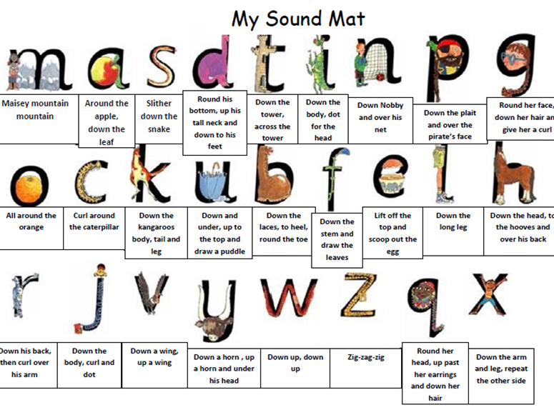
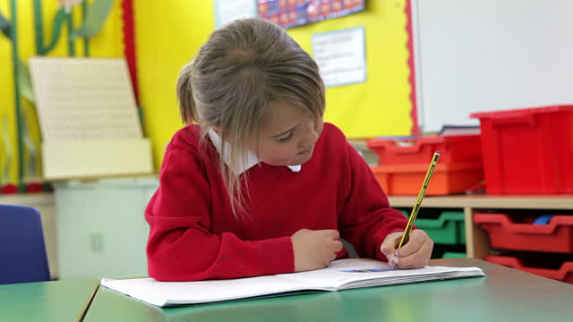
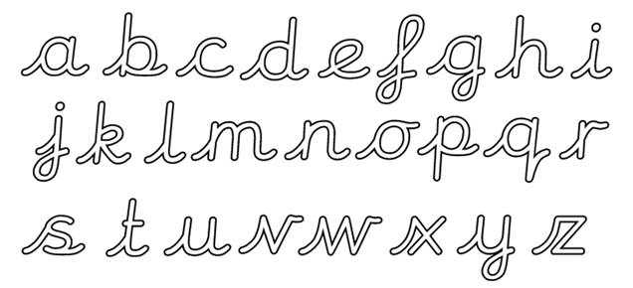
Handwriting
Cursive
Daily
Pen license

Slide 10
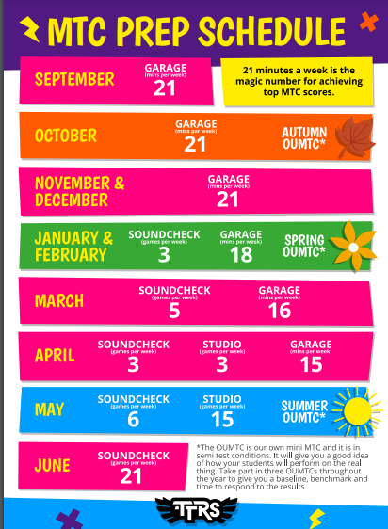
How to help at home…
Reading- Daily Reading
Times tables- Daily times tables or TTRS
Weekly Home Learning- set task and ideas sheet
Note- Glasses and hearing tests

Slide 11
Parent Class Representative
We are introducing a Parent Class Representative for each class in the school this year. The reps meet with the Senior Leadership Team each term and share celebrations and any concerns from the parents in their year group.
What we are looking for –
A parent who is regularly in the playground/talking to other parents/willing to engage with other parents
A parent who is willing to meet, during the school day, once a term with the headteacher or other senior member of staff.
A parent who is not a school parent governor.
A parent who listens well to the views of other parents in order to engage in dialogue with the school
A parent who is interested in making a positive contribution to the school’s development
Are you interested?
If you are interested and feel the following criteria is applicable to you, please email myself at year4@eastway.wirral.sch.uk If more than one name is put forward, the names will be drawn out of a hat.

Slide 12
Thank you
for listening
Any Questions?

