Slide 1
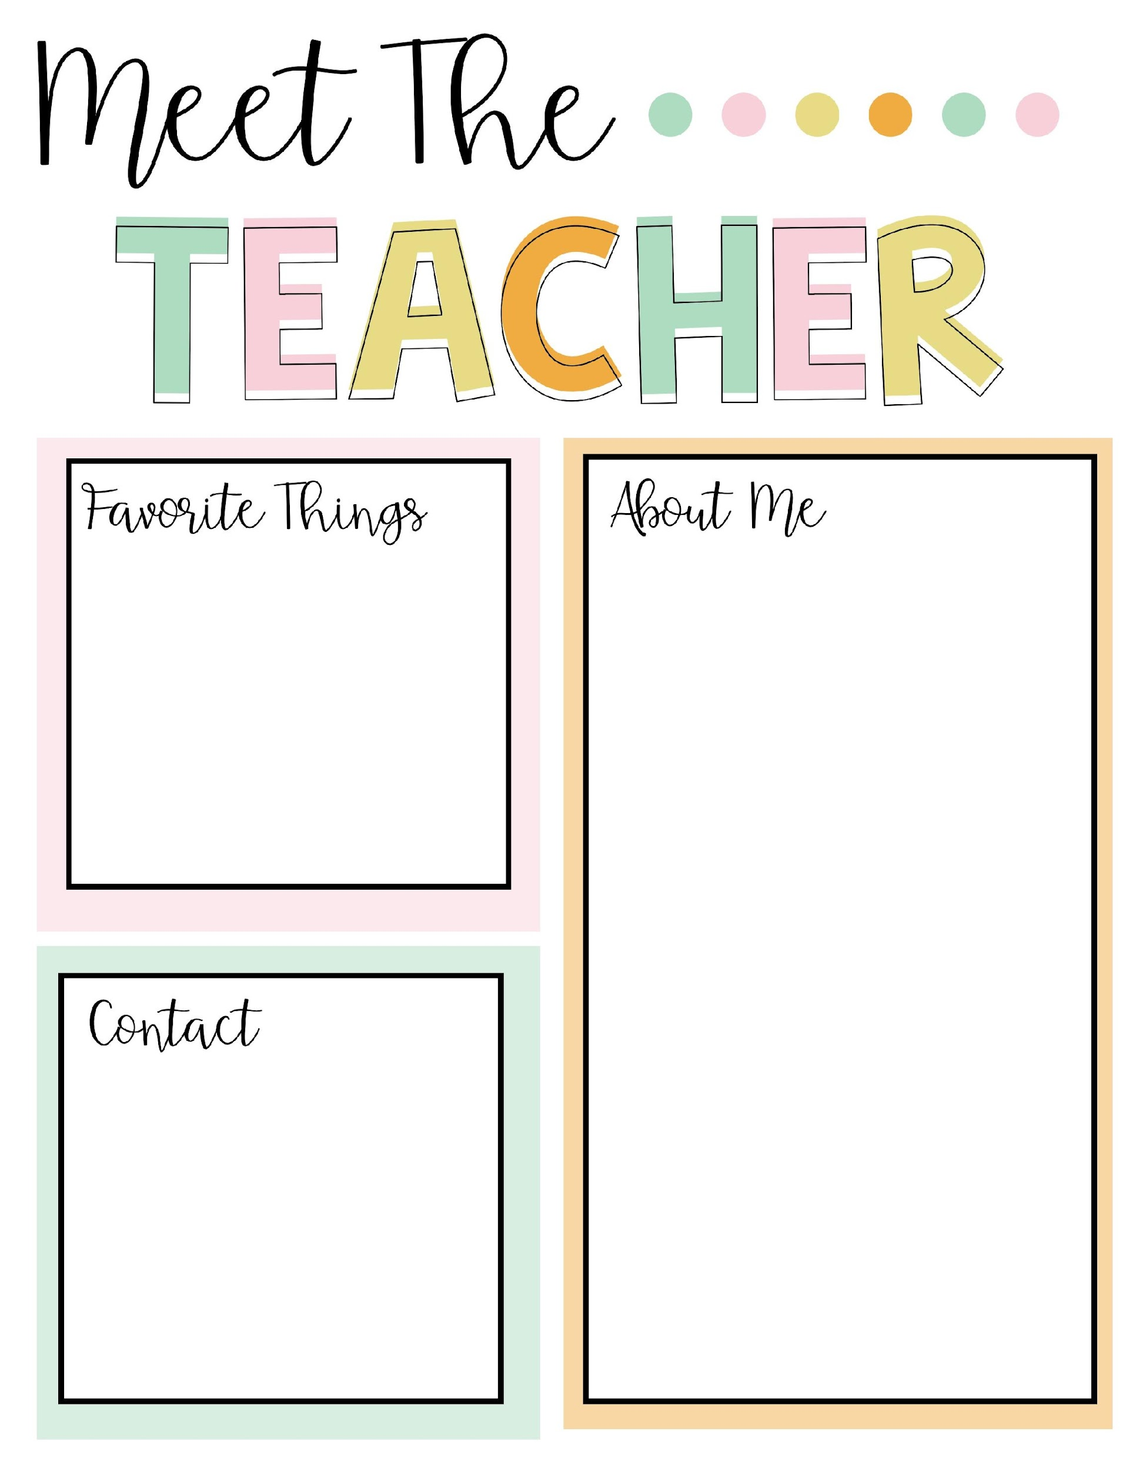
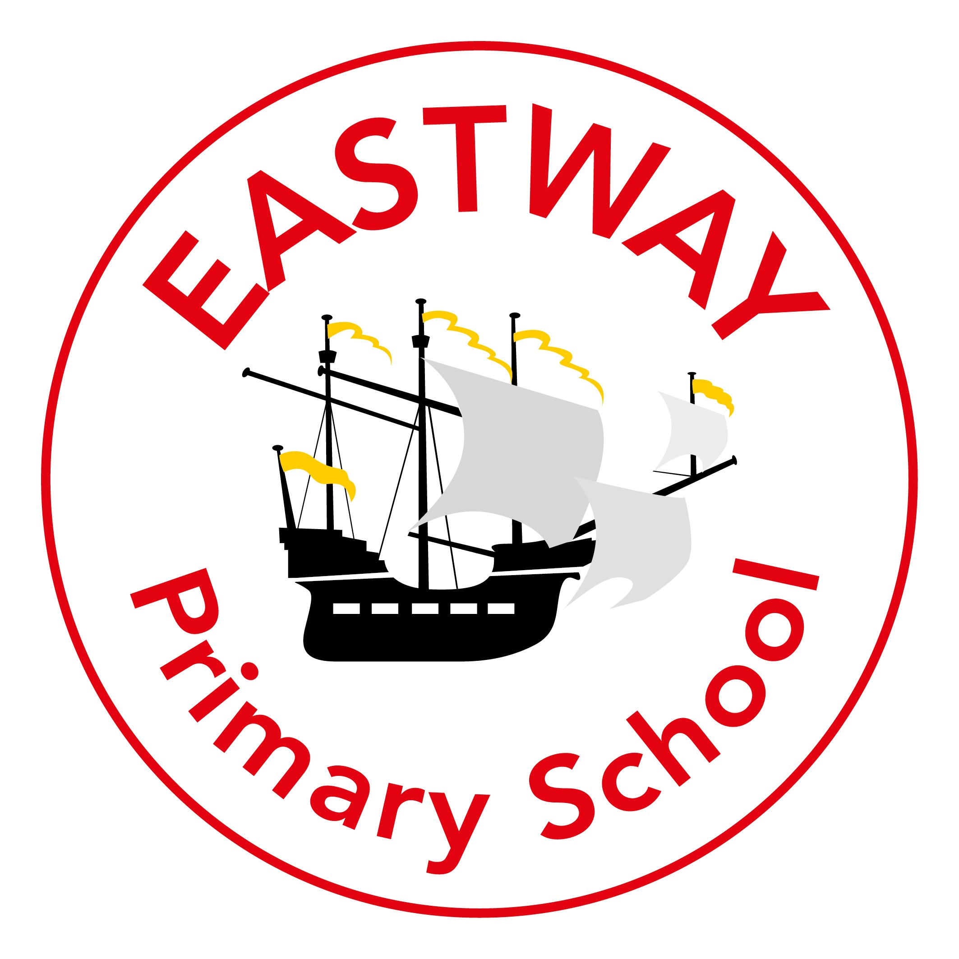
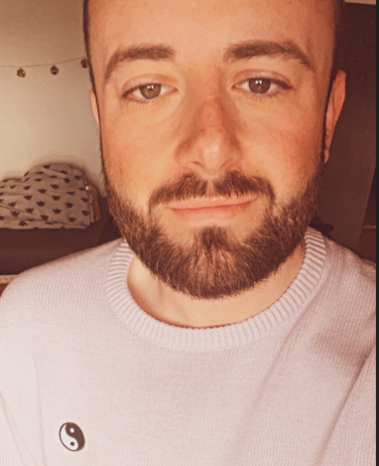
Music – I’m a big Madonna fan
Dogs – all shapes and sizes!
Formula One – I’m a Ferrari and McLaren fan.
My favourite colour is yellow.
My favourite food would be Chinese but I am always eating crisps!
My Name is Mr Saunderson and I am your new class teacher for 2024/25.
I have been a teacher for 10 years and have worked in the Wirral for this time. I have taught in Foundation 2, Year 1, Year 2 and this will be my second year in Year 3.
I completed my first degree in Leeds University and then started my teacher training in John Moores University in 2015. I now live over in New Brighton.
I enjoy playing rugby in my spare time - I play for the Liverpool Tritons in the link position!
Here are a few fun facts about me:
As a teenager, I lived in Alabama for a year and went to an American high school – it’s just like the movies!
I was caught in a tornado while living there – it was a scary experience!
I was born in Wales but was raised in Old Swan in Liverpool.
It is important that
we stay in touch
and you know you
can chat to me
when you need to. There are lots of opportunities through the year but you can also catch me at the end of the day. Email is the best way to contact me.
year2@eastway.wirral.sch.uk

