Slide 1

Welcome
Eastway Primary School
You will find some information regarding:
Hear about our whole school expectations and working with our families.
Find out more information about what is taught.
Know what the class routines are and things specifically important to our year group.
Look at ways we can all work together.

Slide 2
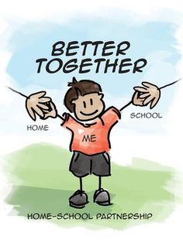
Welcome to a new school year
Working in Partnership
Uniform
Home Learning
Communication
Attendance

Slide 3
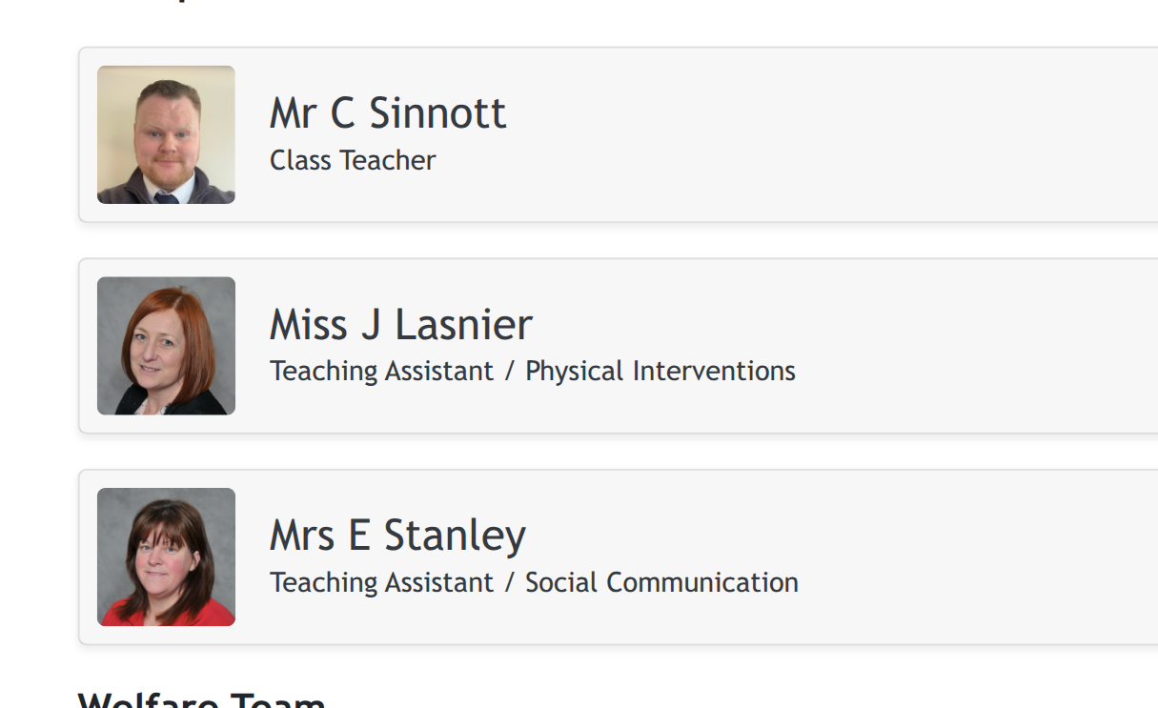
Welcome to Enterprise
The Team
Mr Sinnott
Mrs Lasnier
Mr Sinnott
Mrs Stanley
Mrs Mandel

Slide 4
Enterprise Time table
Morning:
English (reading and writing)
Maths
Afternoon subjects, including:
science, history/geography, art/DT, music, French, PE, PSHE, RE, life skills

Slide 5
Routines
Children arrive from transport approx. 8.40
We settle in with gentle learning activities
Morning lessons focus on English and Maths. Afternoon lessons focus on other subjects.
We regularly check in with our learners to allow them to express their thoughts and feelings.

Slide 6
Enterprise Base
Uniform items- please label if you can, it helps to find missing items!
We use classdojo to communicate regularly. We ask for honest, respectful communication and we will provide the same. Phone calls are also available. Please be aware this communication has to take place during non-contact times with your child so responses may not be immediate.

Slide 7
Key Messages
We are aiming to promote independence and resilience in our learners. We have high expectations of all learners but of course we adapt to their needs.
Home Learning - reading daily and regular times tables rockstars login please!
We use our children’s learning plans, informed by EHCP targets, to plan our lessons.

Slide 8
What to bring to school?
Home School Reading Book
Class Library Book
Reading Record
Spelling record book
Glasses if required
No stationery equipment from home needed.
We have provided a clear, sturdy plastic bag for items.
Notes:
Now I’m going onto what your child will be bringing home.
Last week your child was sent with their blue book bag/ reading folder (show) containing:
An Oxford Reading Tree book
A Reading Record
A Library book
And their word wallets
They will be sent home each evening and should be returned to school every morning. The books will be changed weekly depending on the day the child reads at school.

Slide 9
How to help at home…
Reading- Daily Reading
TT Rockstars
Keep in touch- let us know about anything that may affect your child’s learning: a poor night’s sleep, etc. It helps us to help them.

