Slide 1
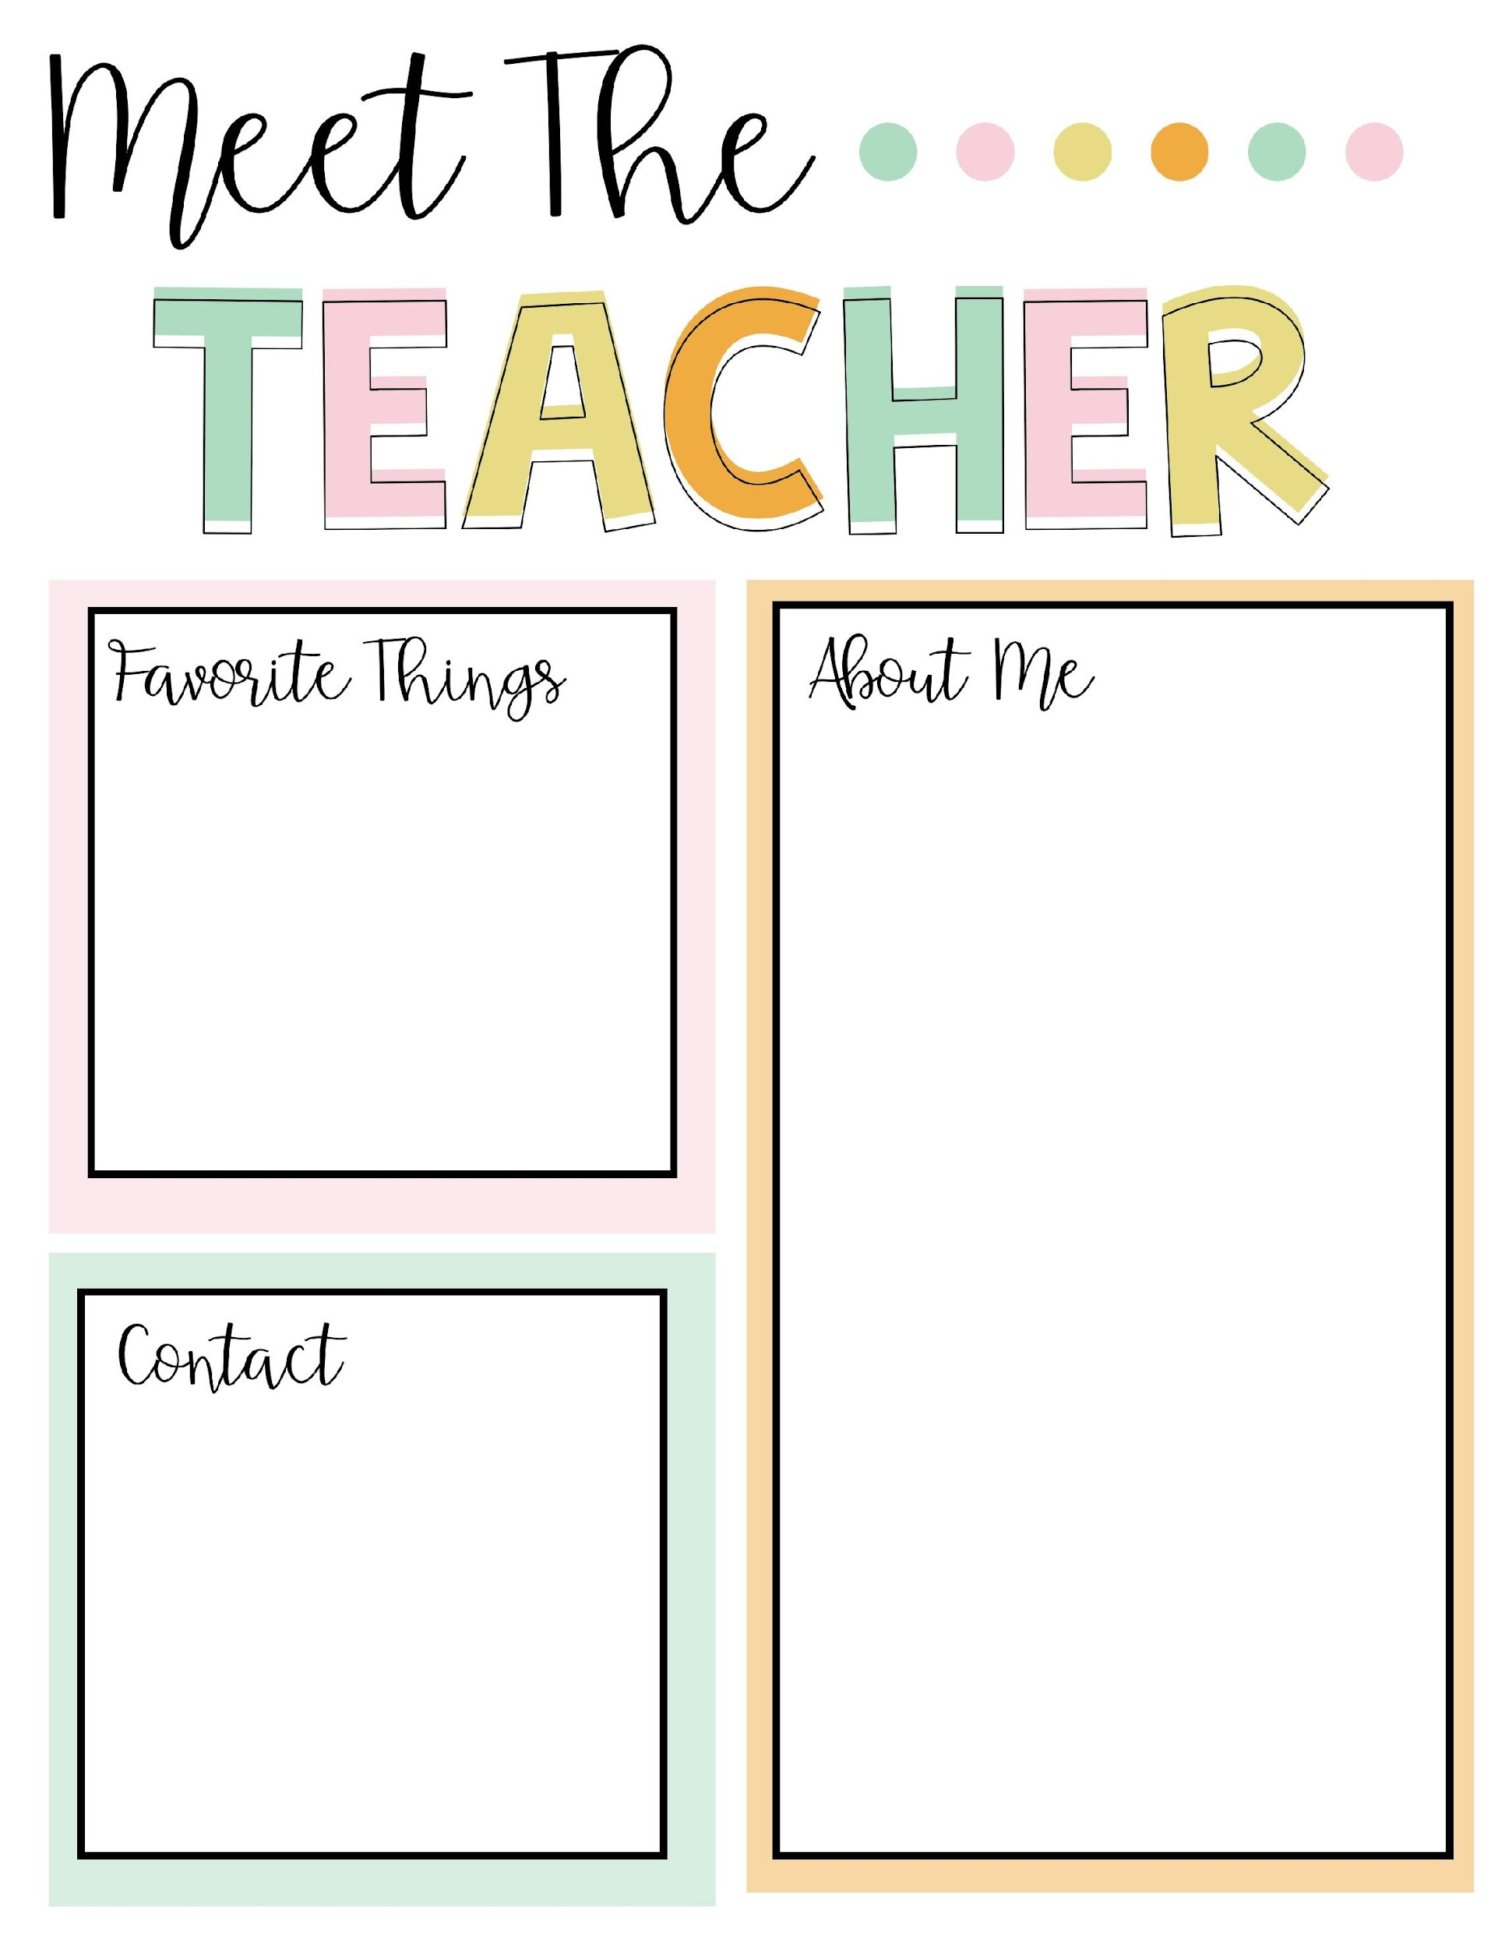
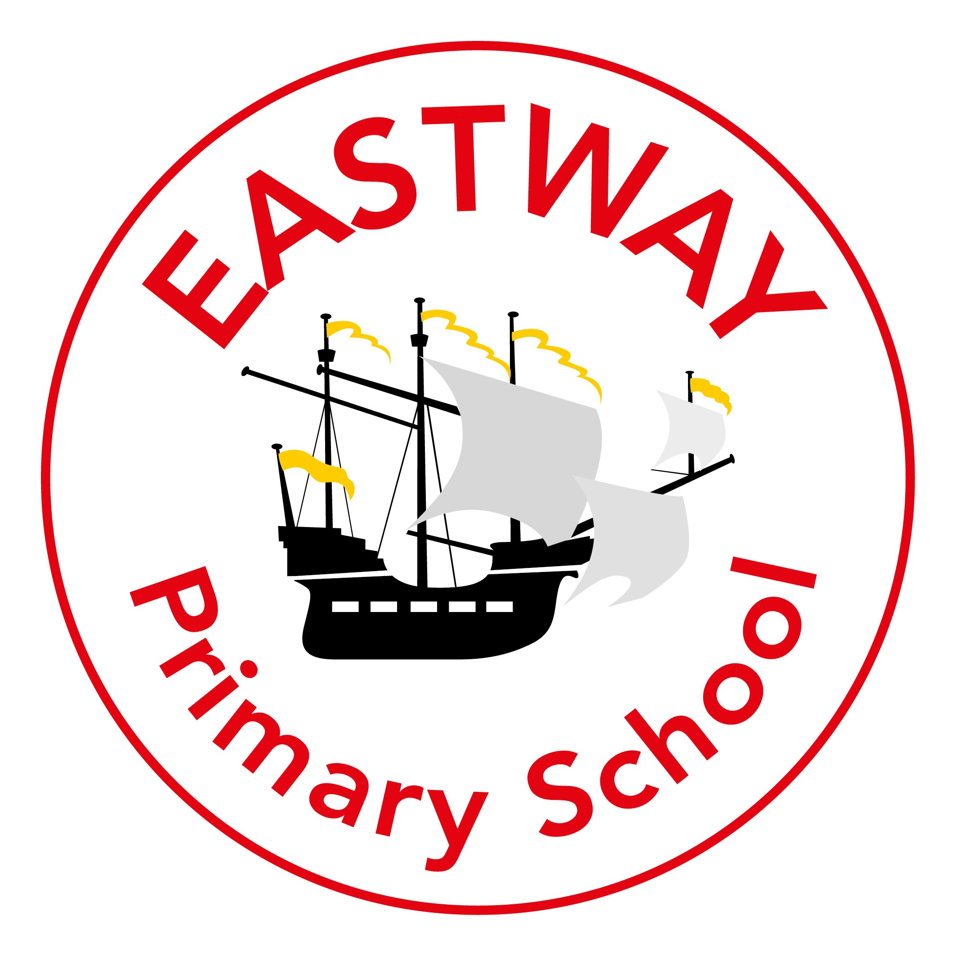



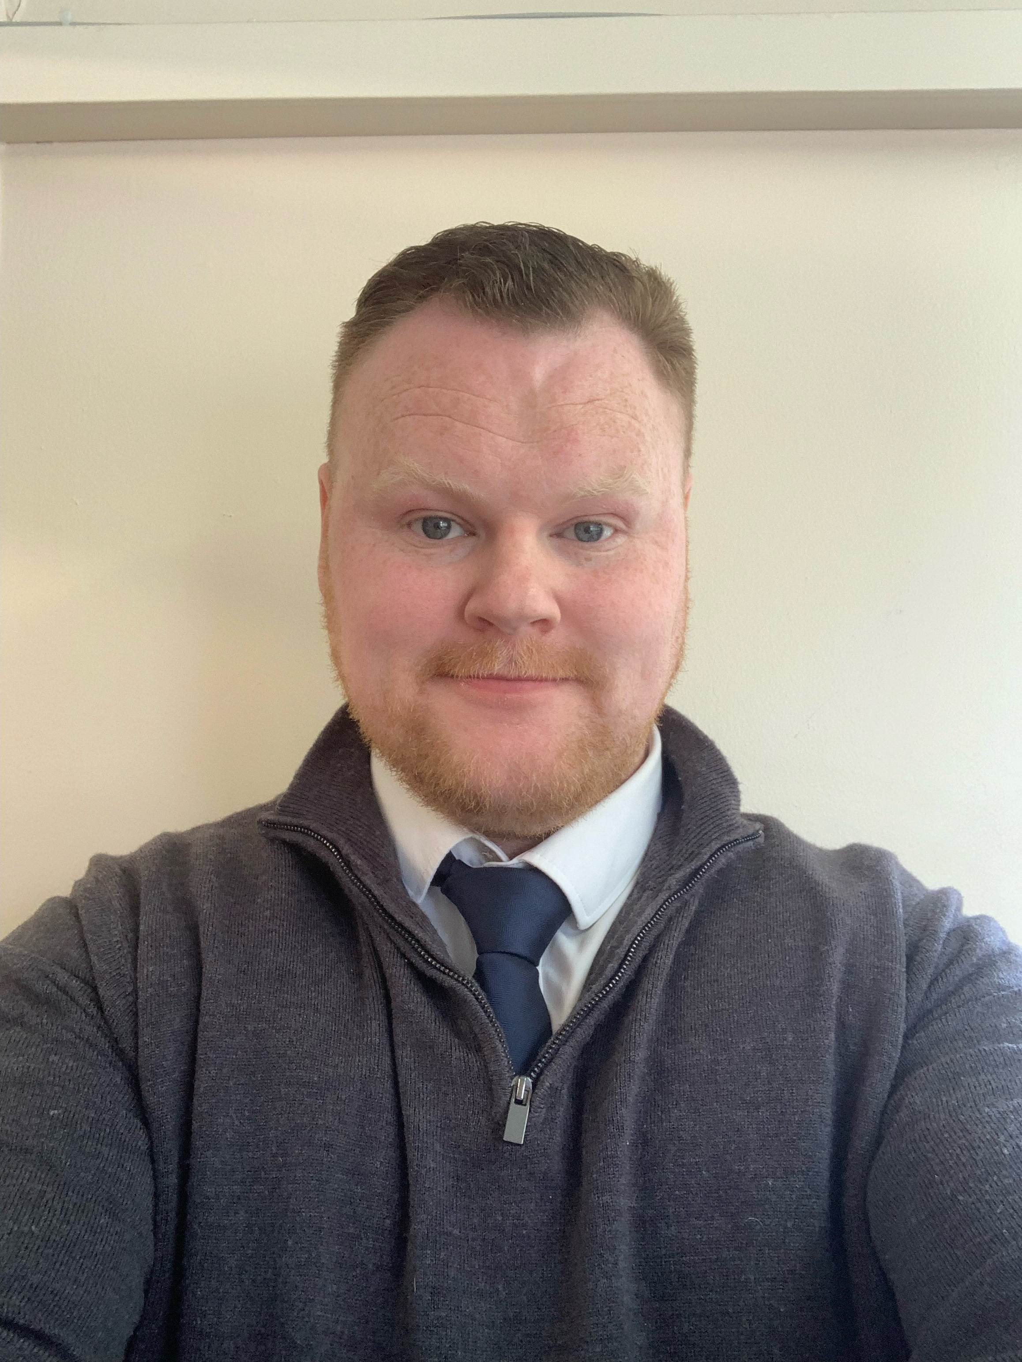
My name is Mr Sinnott and I am your new class teacher for 2025-2026.
I have taught in schools in Liverpool over the past 14 years. I have enjoyed teaching children in all year groups but have spent most of my time teaching KS2, particularly in Y5 and Y6. In my spare time, I like to read books on a range of subjects. I am especially interested in learning about history: the Roman Empire, the American Revolution and the Second World War. Mrs Sinnott says I have far too many books!
I am also trying very hard to learn German and Greek. They are both a challenge but I believe if something is hard then it is probably worth doing.
Here are a few fun facts about me:
I have practised karate for a long time.
I enjoy making models of aircraft, tanks and other WW2 vehicles.
I love taking part in quizzes and once appeared on The Chase. (I did not win!)
My cat Amber and my hamster Franklin
Books about lots of topics
Making scale models
Science (my hamster is named after Benjamin Franklin)
Learning new facts about our wonderful world
It is important that
we stay in touch
and you know you
can chat to me
when you need to. There are lots of opportunities through the year but you can also catch me at the end of the day. Class dojo is the best way to contact me.

